Slide 1
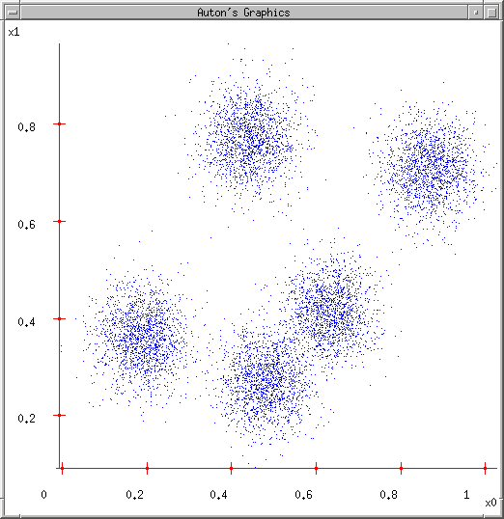
K-means and Hierarchical Clustering
Note to other teachers and users of these slides. Andrew would be delighted if you found this source material useful in giving your own lectures. Feel free to use these slides verbatim, or to modify them to fit your own needs. PowerPoint originals are available. If you make use of a significant portion of these slides in your own lecture, please include this message, or the following link to the source repository of Andrew’s tutorials: http://www.cs.cmu.edu/~awm/tutorials
. Comments and corrections gratefully received.
Andrew W. Moore Professor
School of Computer Science Carnegie Mellon University
www.cs.cmu.edu/~awm awm@cs.cmu.edu
412-268-7599
Copyright © 2001, Andrew W. Moore
Nov 16th, 2001
Some Data
This could easily be modeled by a Gaussian Mixture (with 5 components)
But let’s look at an satisfying, friendly and infinitely popular alternative…
Copyright © 2001, 2004, Andrew W. Moore
K-means and Hierarchical Clustering: Slide 2

Slide 2
Suppose you transmit the coordinates of points drawn randomly from this dataset.
You can install decoding software at the receiver.
You’re only allowed to send two bits per point.
It’ll have to be a “lossy transmission”.
Loss = Sum Squared Error between decoded coords and original coords.
What encoder/decoder will lose the least information?
Lossy Compression
Copyright © 2001, 2004, Andrew W. Moore
K-means and Hierarchical Clustering: Slide 3
Suppose you transmit the coordinates of points Bdrreaawk ninto a grid,
Idea One
randomly from this da^{d}t^{e}a^{c}sºe^{d}t^{e}. ^{each bit-pair}
as the middle of You can install decodienagch grid-cell software at the receiver.
You’re only allowed to send two bits per point.
It’ll have to be a “lossy transmission”.
Loss = Sum Squared Error between decoded coords and original coords.
What encoder/decoder will lose the least information?
Copyright © 2001, 2004, Andrew W. Moore
00
01
10
11
Any Better Ideas?
K-means and Hierarchical Clustering: Slide 4

Slide 3
Suppose you transmit the
coordinates of poinBtrseadkrainwtona grid, decode
Idea Two
randomly from this^{e}d^{ac}a^{h}ta^{b}s^{it}e^{-p}t.^{air as the}
centroid of all data in
You can install decothdaitnggrid-cell software at the receiver.
You’re only allowed to send two bits per point.
It’ll have to be a “lossy transmission”.
Loss = Sum Squared Error
00
01
10
11
between decoded coords and original coords.
What encoder/decoder will lose the least information?
Copyright © 2001, 2004, Andrew W. Moore K-means and Hierarchical Clustering: Slide 5
Any Further Ideas?
K-means
1. Ask user how many clusters they’d like. (e.g. k=5)
Copyright © 2001, 2004, Andrew W. Moore
K-means and Hierarchical Clustering: Slide 6

Slide 4
K-means
Ask user how many clusters they’d like. (e.g. k=5)
Randomly guess k cluster Center locations
Copyright © 2001, 2004, Andrew W. Moore
K-means and Hierarchical Clustering: Slide 7
K-means
Ask user how many clusters they’d like. (e.g. k=5)
Randomly guess k cluster Center locations
Each datapoint finds out which Center it’s closest to. (Thus each Center “owns” a set of datapoints)
Copyright © 2001, 2004, Andrew W. Moore
K-means and Hierarchical Clustering: Slide 8

Slide 5

K-means
Ask user how many clusters they’d like. (e.g. k=5)
Randomly guess k cluster Center locations
Each datapoint finds out which Center it’s closest to.
Each Center finds the centroid of the points it owns
Copyright © 2001, 2004, Andrew W. Moore
K-means and Hierarchical Clustering: Slide 9
K-means
Ask user how many clusters they’d like. (e.g. k=5)
Randomly guess k cluster Center locations
Each datapoint finds out which Center it’s closest to.
Each Center finds the centroid of the points it owns…
…and jumps there
…Repeat until terminated!
Copyright © 2001, 2004, Andrew W. Moore
K-means and Hierarchical Clustering: Slide 10

Slide 6
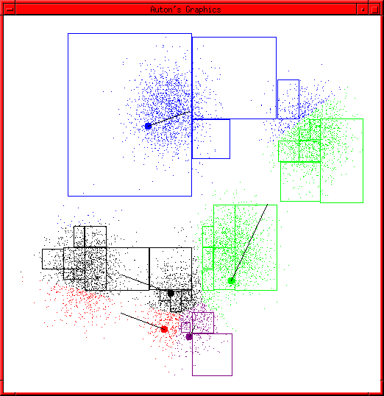
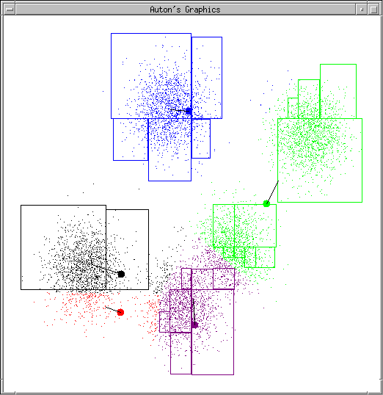
K-means Start
Advance apologies: in Black and White this example will deteriorate
Example generated by Dan Pelleg’s super-duper fast K-means system:
Dan Pelleg and Andrew Moore. Accelerating Exact k-means Algorithms with Geometric Reasoning.
Proc. Conference on
Knowledge Discovery in Databases 1999, (KDD99) (available on www.autonlab.org/pap.html)
Copyright © 2001, 2004, Andrew W. Moore
K-means and Hierarchical Clustering: Slide 11
K-means continues
…
Copyright © 2001, 2004, Andrew W. Moore
K-means and Hierarchical Clustering: Slide 12

Slide 7
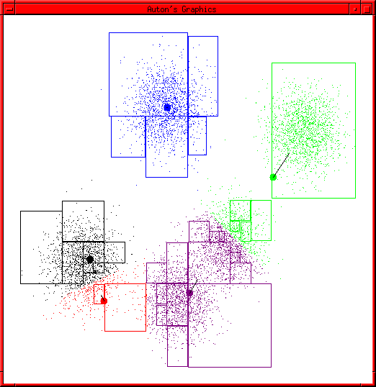
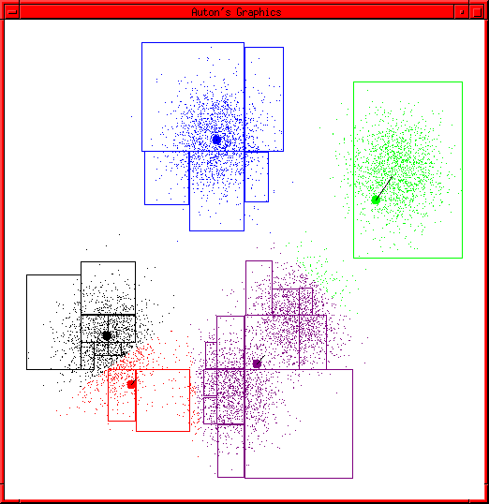
K-means continues
…
Copyright © 2001, 2004, Andrew W. Moore
K-means and Hierarchical Clustering: Slide 13
K-means continues
…
Copyright © 2001, 2004, Andrew W. Moore
K-means and Hierarchical Clustering: Slide 14

Slide 8
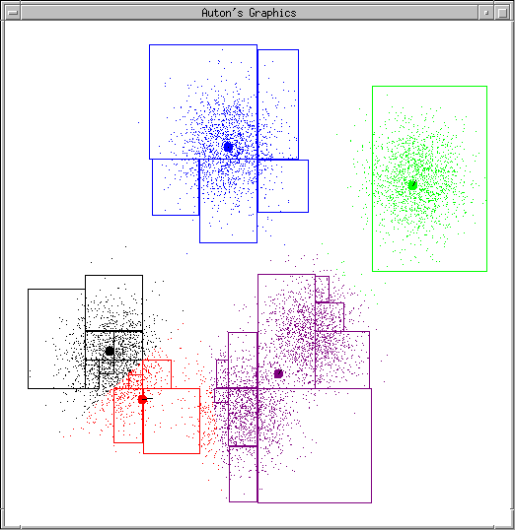
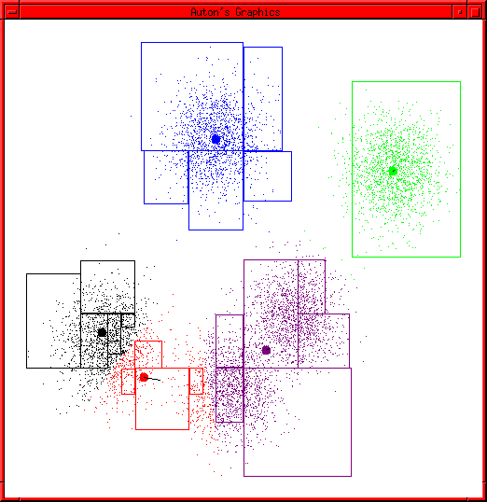
K-means continues
…
Copyright © 2001, 2004, Andrew W. Moore
K-means and Hierarchical Clustering: Slide 15
K-means continues
…
Copyright © 2001, 2004, Andrew W. Moore
K-means and Hierarchical Clustering: Slide 16

Slide 9
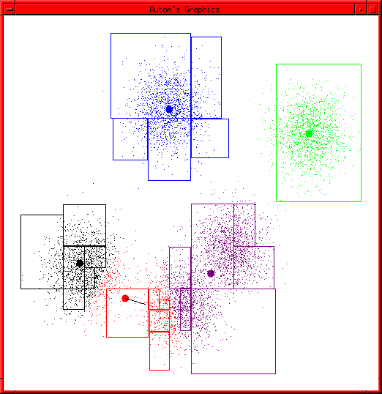
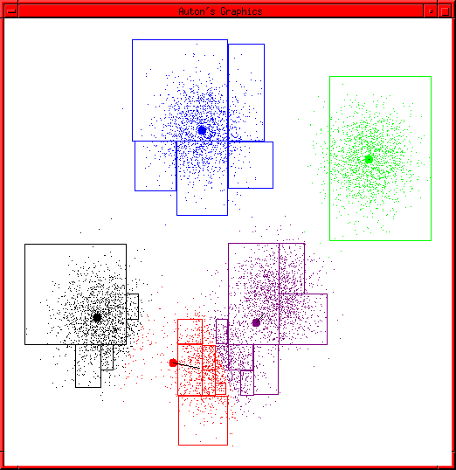
K-means continues
…
Copyright © 2001, 2004, Andrew W. Moore
K-means and Hierarchical Clustering: Slide 17
K-means continues
…
Copyright © 2001, 2004, Andrew W. Moore
K-means and Hierarchical Clustering: Slide 18

Slide 10
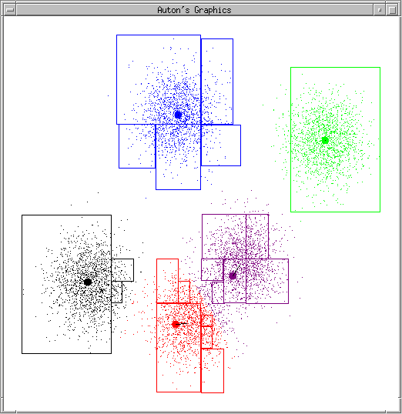
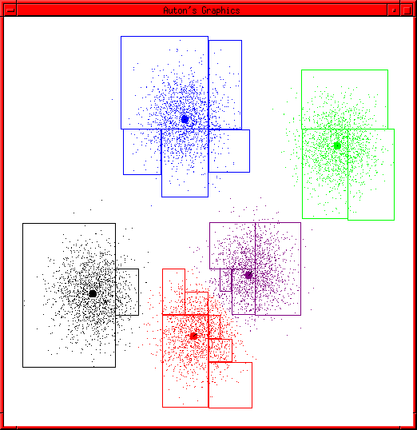
K-means continues
…
Copyright © 2001, 2004, Andrew W. Moore
K-means and Hierarchical Clustering: Slide 19
K-means terminates
Copyright © 2001, 2004, Andrew W. Moore
K-means and Hierarchical Clustering: Slide 20

Slide 11
K-means Questions
What is it trying to optimize?
Are we sure it will terminate?
Are we sure it will find an optimal clustering?
How should we start it?
How could we automatically choose the number of centers?
….we’ll deal with these questions over the next few slides
Copyright © 2001, 2004, Andrew W. Moore
K-means and Hierarchical Clustering: Slide 21
Distortion
Given..
•an encoder function: ENCODE : ℜ^{m} → [1..k]
•a decoder function: DECODE : [1..k] → ℜ^{m}
Define…
R
Distortion = (
[ENCODE(x )])
∑ i
x − DECODE
i
2
i=1
Copyright © 2001, 2004, Andrew W. Moore
K-means and Hierarchical Clustering: Slide 22

Slide 12
Distortion
Given..
•an encoder function: ENCODE : ℜ^{m} → [1..k]
•a decoder function: DECODE : [1..k] → ℜ^{m}
Define…
R
Distortion = (
[ENCODE(x )])
∑ i
x − DECODE
i
2
i=1
We may as well write
DECODE[ j] = c _{j}
R
so Distortion = ∑(x − c
i ENCODE(x_{i} )
₎2
i=1
Copyright © 2001, 2004, Andrew W. Moore
K-means and Hierarchical Clustering: Slide 23
The Minimal Distortion
R
Distortion = ∑(x − c
i ENCODE(x_{i} )
₎2
i=1
What properties must centers c₁ , c₂ , … , c_{k} have when distortion is minimized?
Copyright © 2001, 2004, Andrew W. Moore
K-means and Hierarchical Clustering: Slide 24

Slide 13
The Minimal Distortion (1)
R
Distortion = ∑(x − c
i ENCODE(x_{i} )
₎2
i=1
What properties must centers c₁ , c₂ , … , c_{k} have when distortion is minimized?
(1) x_{i} must be encoded by its nearest center
….why?
c
ENCODE(x_{i} )
= arg min (x − c )²
c _{j} ∈{c₁ ,c₂ ,...c_{k} }
i j
..at the minimal distortion
Copyright © 2001, 2004, Andrew W. Moore
K-means and Hierarchical Clustering: Slide 25
The Minimal Distortion (1)
R
Distortion = ∑(x − c
i ENCODE(x_{i} )
₎2
i=1
What properties must centers c₁ , c₂ , … , c_{k} have when distortion is minimized?
(1) x_{i} must be encoded by its nearest center
Otherwise distortion could be
….why?
reduced by replacing ENCODE[x_{i}] by the nearest center
c
= arg min (x − c )²
ENCODE(x_{i} ) i j
c _{j} ∈{c₁ ,c₂ ,...c_{k} }
..at the minimal distortion
Copyright © 2001, 2004, Andrew W. Moore
K-means and Hierarchical Clustering: Slide 26

Slide 14
The Minimal Distortion (2)
R
Distortion = ∑(x − c
i ENCODE(x_{i} )
₎2
i=1
What properties must centers c₁ , c₂ , … , c_{k} have when distortion is minimized?
(2) The partial derivative of Distortion with respect to each center location must be zero.
Copyright © 2001, 2004, Andrew W. Moore
K-means and Hierarchical Clustering: Slide 27
(2) The partial derivative of Distortion with respect to each center location must be zero.
R
Distortion =
∑(x − c
i ENCODE( x_{i} )
₎2
i=1 k
=
∑ ∑
(x_{i} − c _{j} )
2
OwnedBy(c_{j} ) = the set of records owned by Center c_{j} .
j =1 i∈OwnedBy(c _{j} )
∂Distortion ₌ ∂
∂c _{j} ∂c
∑
(x_{i} − c _{j} )
2
j i∈OwnedBy(c _{j} )
= − 2 ∑(x_{i} − c _{j} )
i∈OwnedBy(c _{j} )
= 0 (for a minimum)
Copyright © 2001, 2004, Andrew W. Moore
K-means and Hierarchical Clustering: Slide 28

Slide 15
(2) The partial derivative of Distortion with respect to each center location must be zero.
R
Distortion =
∑(x − c
i ENCODE( x_{i} )
₎2
i=1 k
=
∑ ∑
(x_{i} − c _{j} )
2
j =1 i∈OwnedBy(c _{j} )
∂Distortion ₌ ∂
∂c _{j} ∂c
∑
(x_{i} − c _{j} )
2
j i∈OwnedBy(c _{j} )
= − 2 ∑(x_{i} − c _{j} )
i∈OwnedBy(c _{j} )
= 0 (for a minimum)
Thus, at a minimum: c
₌ 1
∑ x
j
| OwnedBy(c ) |
i
Copyright © 2001, 2004, Andrew W. Moore
j i∈OwnedBy(c _{j} )
K-means and Hierarchical Clustering: Slide 29
At the minimum distortion
R
Distortion = ∑(x − c
i ENCODE(x_{i} )
₎2
i=1
What properties must centers c₁ , c₂ , … , c_{k} have when distortion is minimized?
x_{i} must be encoded by its nearest center
Each Center must be at the centroid of points it owns.
Copyright © 2001, 2004, Andrew W. Moore
K-means and Hierarchical Clustering: Slide 30

Slide 16
Improving a suboptimal configuration…
R
Distortion = ∑(x − c
i ENCODE(x_{i} )
₎2
i=1
What properties can be changed for centers c₁ , c₂ , … , c_{k}
have when distortion is not minimized?
Change encoding so that x_{i} is encoded by its nearest center
Set each Center to the centroid of points it owns.
There’s no point applying either operation twice in succession. But it can be profitable to alternate.
…And that’s K-means!
Easy to prove this procedure will terminate in a state at which neither (1) or (2) change the configuration. Why?
Copyright © 2001, 2004, Andrew W. Moore K-means and Hierarchical Clustering: Slide 31
Improving a suboptimal configuration…
R
There are only a finite number of ways of partitioning R
Distortion = ∑(x − c
₎2
records into k groups.
i ENCODE(x_{i} )
So there are only a finite number of possible
i=1
What properties can be changed for centers c₁ , c₂ , … , c_{k}
have when distortion is not minimized?
Change encoding so that x_{i} is encoded by its nearest center
Set each Center to the centroid of points it owns.
There’s no point applying either operation twice in succession. But it can be profitable to alternate.
…And that’s K-means!
Easy to prove this procedure will terminate in a state at which neither (1) or (2) change the configuration. Why?
configurations in which all Centers are the centroids of
the points they own.
If the configuration changes on an iteration, it must have
improved the distortion.
So each time the configuration changes it must go to a
configuration it’s never been to before.
So if it tried to go on forever, it would eventually run out
of configurations.
Copyright © 2001, 2004, Andrew W. Moore K-means and Hierarchical Clustering: Slide 32

Slide 17
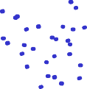


Will we find the optimal configuration?
Not necessarily.
Can you invent a configuration that has converged, but does not have the minimum distortion?
Copyright © 2001, 2004, Andrew W. Moore
K-means and Hierarchical Clustering: Slide 33
Will we find the optimal configuration?
Not necessarily.
Can you invent a configuration that has converged, but does not have the minimum distortion? (Hint: try a fiendish k=3 configuration here…)
Copyright © 2001, 2004, Andrew W. Moore
K-means and Hierarchical Clustering: Slide 34

Slide 18
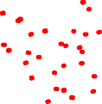
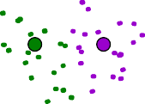




Will we find the optimal configuration?
Not necessarily.
Can you invent a configuration that has converged, but does not have the minimum distortion? (Hint: try a fiendish k=3 configuration here…)
Copyright © 2001, 2004, Andrew W. Moore
K-means and Hierarchical Clustering: Slide 35
Trying to find good optima
Idea 1: Be careful about where you start
Idea 2: Do many runs of k-means, each from a different random start configuration
Many other ideas floating around.
Copyright © 2001, 2004, Andrew W. Moore
K-means and Hierarchical Clustering: Slide 36

Slide 19
Trying to find good optima
Idea 1: Be careful about where you start
Idea 2: Do many runs of k-means, each fromNeaatdtirficfke:rent random start configuration
_{Man}P_{y}la_{o}ce_{th}fi_{e}rs_{r}t c_{id}en_{e}t_{a}er_{s}o_{f}n_{lo}to_{a}p_{ti}o_{n}f_{g}ran_{a}d_{r}o_{o}m_{u}l_{n}y _{d}ch.osen datapoint.
Place second center on datapoint that’s as far away as possible from first center
:
Place j’th center on datapoint that’s as far away as possible from the closest of Centers 1 through j-1
:
Copyright © 2001, 2004, Andrew W. Moore
K-means and Hierarchical Clustering: Slide 37
Choosing the number of Centers
A difficult problem
Most common approach is to try to find the solution that minimizes the Schwarz Criterion (also related to the BIC)
Distortion + λ (# parameters) log R
= Distortion + λmk log R
m=#dimensions
k=#Centers
R=#Records
Copyright © 2001, 2004, Andrew W. Moore
K-means and Hierarchical Clustering: Slide 38

Slide 20
Common uses of K-means
Often used as an exploratory data analysis tool
In one-dimension, a good way to quantize real- valued variables into k non-uniform buckets
Used on acoustic data in speech understanding to convert waveforms into one of k categories (known as Vector Quantization)
Also used for choosing color palettes on old fashioned graphical display devices!
Copyright © 2001, 2004, Andrew W. Moore
K-means and Hierarchical Clustering: Slide 39
Single Linkage Hierarchical Clustering
1. Say “Every point is its own cluster”
Copyright © 2001, 2004, Andrew W. Moore
K-means and Hierarchical Clustering: Slide 40

Slide 21

Single Linkage Hierarchical Clustering
Say “Every point is its own cluster”
Find “most similar” pair of clusters
Copyright © 2001, 2004, Andrew W. Moore
K-means and Hierarchical Clustering: Slide 41
Single Linkage Hierarchical Clustering
Say “Every point is its own cluster”
Find “most similar” pair of clusters
Merge it into a parent cluster
Copyright © 2001, 2004, Andrew W. Moore
K-means and Hierarchical Clustering: Slide 42

Slide 22


Single Linkage Hierarchical Clustering
Say “Every point is its own cluster”
Find “most similar” pair of clusters
Merge it into a parent cluster
Repeat
Copyright © 2001, 2004, Andrew W. Moore
K-means and Hierarchical Clustering: Slide 43
Single Linkage Hierarchical Clustering
Say “Every point is its own cluster”
Find “most similar” pair of clusters
Merge it into a parent cluster
Repeat
Copyright © 2001, 2004, Andrew W. Moore
K-means and Hierarchical Clustering: Slide 44

Slide 23
Single Linkage Hierarchical
How do we define similarity between clusters?
Clustering
Minimum distance between points in clusters (in which case we’re simply doing Euclidian Minimum Spanning Trees)
Maximum distance between points in clusters
Average distance between points in clusters
Say “Every point is its own cluster”
Find “most similar” pair of clusters
Merge it into a parent cluster
Repeat…until you’ve merged the whole dataset into one cluster
You’re left with a nice dendrogram, or taxonomy, or hierarchy of datapoints (not shown here)
Copyright © 2001, 2004, Andrew W. Moore
K-means and Hierarchical Clustering: Slide 45
Also known in the trade as Hierarchical Agglomerative Clustering (note the acronym)
Single Linkage Comments
It’s nice that you get a hierarchy instead of an amorphous collection of groups
If you want k groups, just cut the (k-1) longest links
There’s no real statistical or information- theoretic foundation to this. Makes your lecturer feel a bit queasy.
Copyright © 2001, 2004, Andrew W. Moore
K-means and Hierarchical Clustering: Slide 46

Slide 24
What you should know
All the details of K-means
The theory behind K-means as an optimization algorithm
How K-means can get stuck
The outline of Hierarchical clustering
Be able to contrast between which problems would be relatively well/poorly suited to K- means vs Gaussian Mixtures vs Hierarchical clustering
Copyright © 2001, 2004, Andrew W. Moore
K-means and Hierarchical Clustering: Slide 47

